Slide 1



Slide 2

Professional Smart Card
Supervised by:
M. Jamal Ahmed
Group Members:
Syed Natiq Hussain Shah (SP18-BCS-001)
Yasir Iqbal (SP18-BCS-015)
Department of Computer Science
COMSATS University Islamabad, Attock Campus

Slide 3
Outline
Introduction
Working flow
Comparison table
Problem statement
Objectives
Methodology
Modern tools
Benefits
_______________________________

Slide 4

Introduction
It is the android application which will be design for scanning the professional smart cards which have several implications.
User can take picture of the printed business card and can directly save the contact in his phone.
User can easily create a profile in this application and can save different cards in their profiles which are shared by the different communities.
Social circle would be defined by using QR code.
Suggest the cards of business which is running on the nearby vicinity so that two professionals can exchange it.
_______________________________

Slide 5
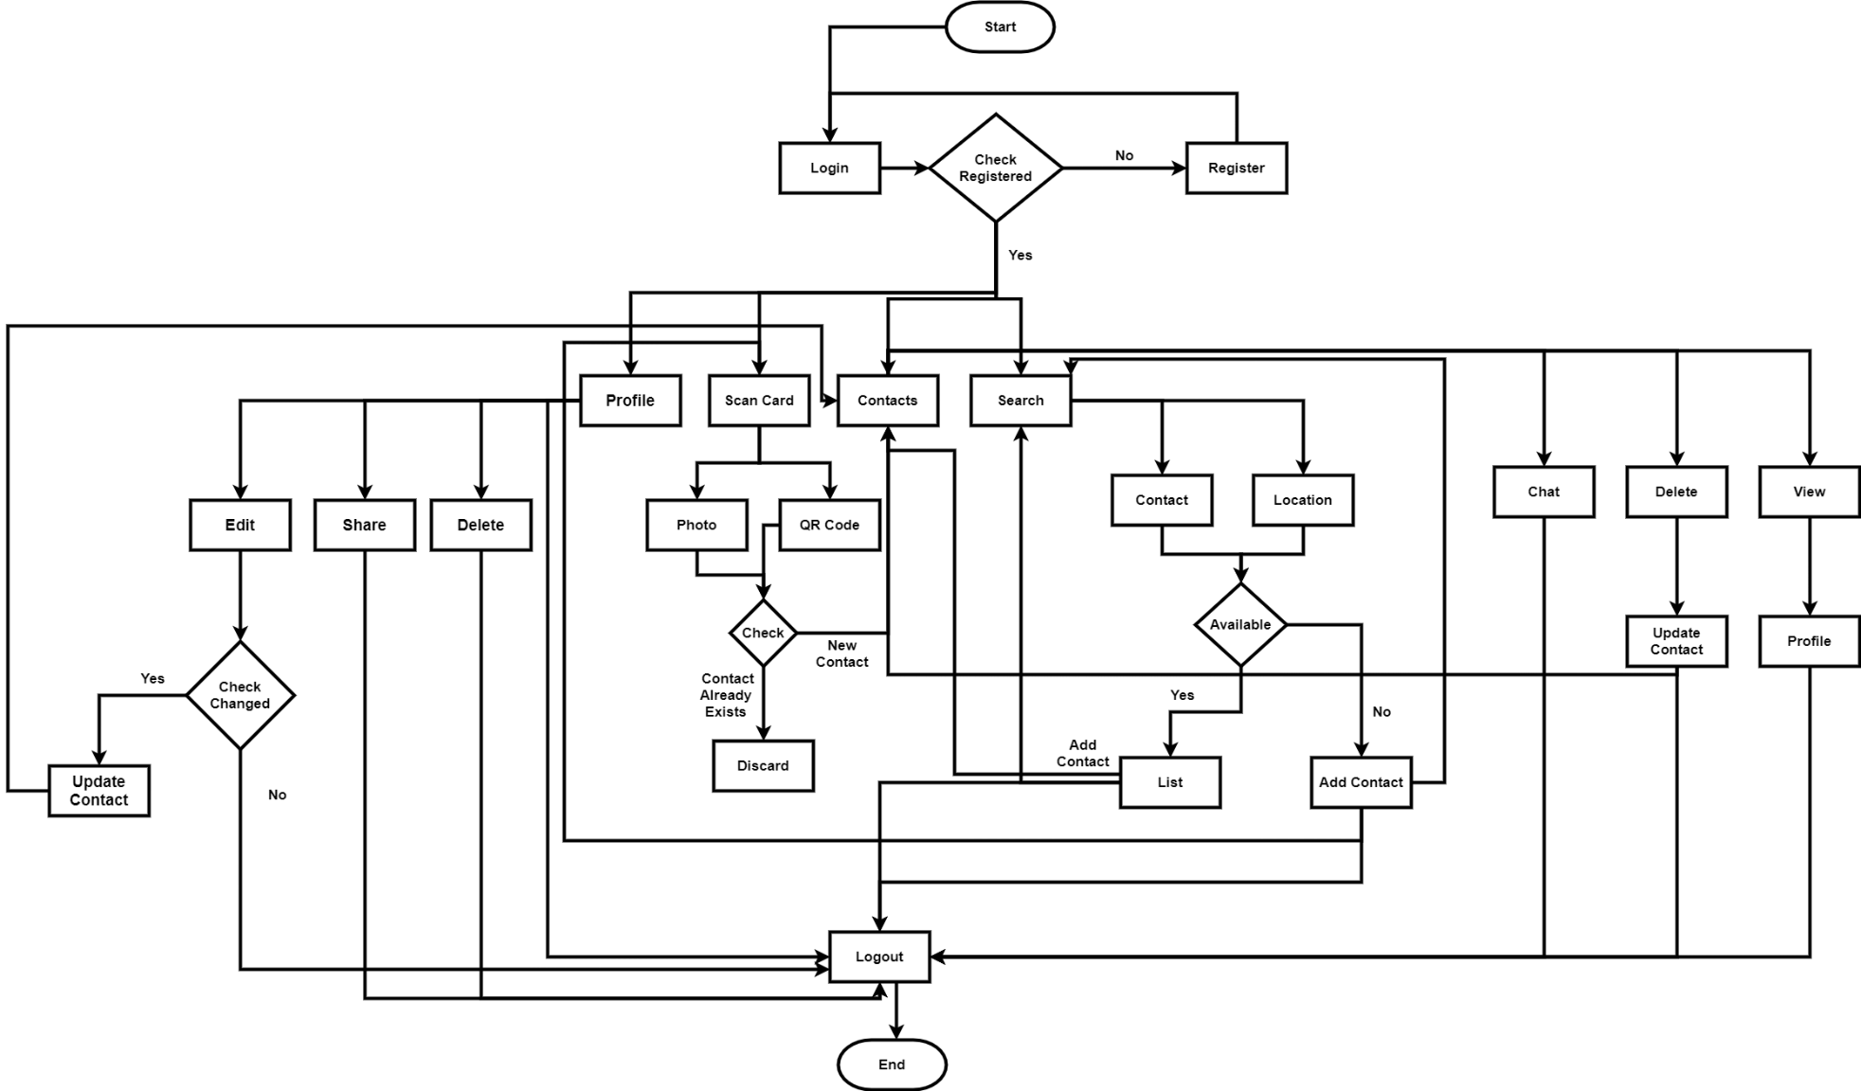
Working flow
_______________________________

Slide 6
Applications And Comparison Table
Functionality | Professional Smart Card (Proposed) | Haystack | Wantedly | Switchit
Scan Cards (Using QR-Code & OCR) | ✔ | ✔ | ✔ | ✔
Social Circle | ✔ | ✖ | ✖ | ✖
Nearby Business Suggestion | ✔ | ✖ | ✔ | ✔
QR Code Scan | ✔ | ✖ | ✖ | ✔
Update Contacts | ✔ | ✔ | ✖ | ✖
Community Chat | ✔ | ✖ | ✖ | ✖
Business Search | ✔ | ✖ | ✔ | ✖
_______________________________

Slide 7
Problem statement
When somebody attends a workshop or seminar, he receives many cards that he will put into his pocket.
Whenever business changes its location or contact information, previous customers which have paper cards doesn’t get to know.
You are unable to locate a particular business near you and find your preferred business.
Chat with community is not possible if you don’t have there contact information saved.
Whenever you change your location you don’t know that a particular business branch is available there or not.
You are unable to find there social circle presence.
_______________________________

Slide 8
Objectives
User can create a profile in which saved cards can be shared.
Businessmen can upload their digital card and share it with the customers.
Using QR code we easily get profile of the person.
A community chat is available for help
A social circle will be defined using QR code.
The phone numbers can be picked from the scanned image.
Suggests the cards of business running on the nearby vicinity to exchange between professional.
_______________________________

Slide 9
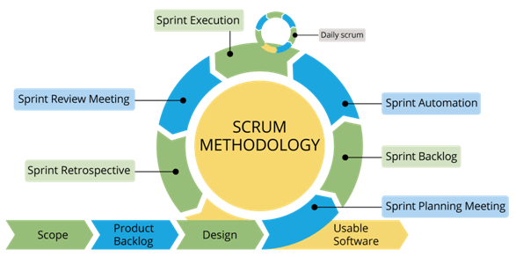
Rationale behind Selected Methodology
Selection of this methodology as we are developing in increment forms so if change require after result showing to supervisor.
As it is incremental based so we can add or remove some features according to needs and supervisor direction.
We can also change the procedure to preform a function when needed if it doesn’t fits in our system.
Different modules can be linked and used as a system in this way and it would be easy to add new features to the existing system.
_______________________________

Slide 10
Modern Tools
Tools And Technologies | Tools | Version | Rationale
 | MS Word | 2016 | Documentation
 | Power Point | 2016 | Presentation
 | Android studio | 4.0.1 | Android development
 | PyCharm |  | Python
 | Technology | Version | Rationale
 | Java | 5 | Programming Language
 | Flask |  | Python Framework
 | Firebase |  | Database
 | Xml |  | Android Designing
 | Python |  | Programming Language

Slide 11
Benefits
No need to carry paper cards.
Manage your contacts easily.
Chat with community and get help easily.
Get social circle of business.
Locate nearby business easily.
Update information about business and changes.
Create your own business card and share with others.
Find a particular business other branches in your preferred location(if available).
Chat with the saved contact and get relevant information.
_______________________________

Slide 12
References
https://link.springer.com/article/10.1134/S1054661819010188
https://link.springer.com/chapter/10.1007/978-3-030-34365-1_18
https://play.google.com/store/apps/details?id=com.wantedly.android.namecard_scanner
https://play.google.com/store/apps/details?id=com.theHaystackApp.haystack
https://play.google.com/store/apps/details?id=com.c7.android.switchit
_______________________________

Slide 13

Professional Smart card Video
_______________________________

Slide 14

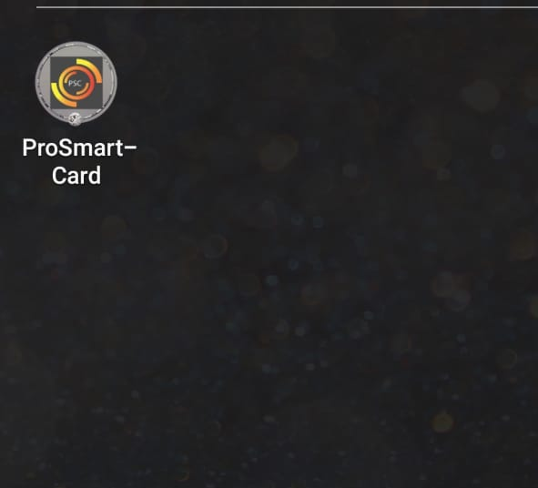
Professional Smart card
_______________________________

Slide 15
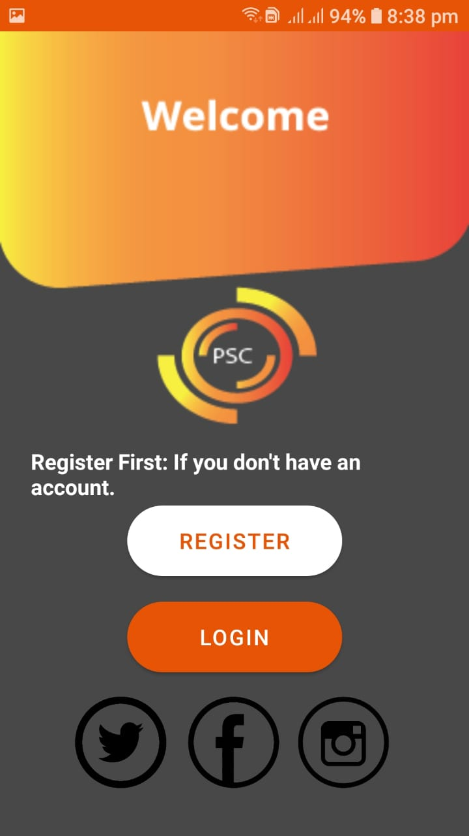
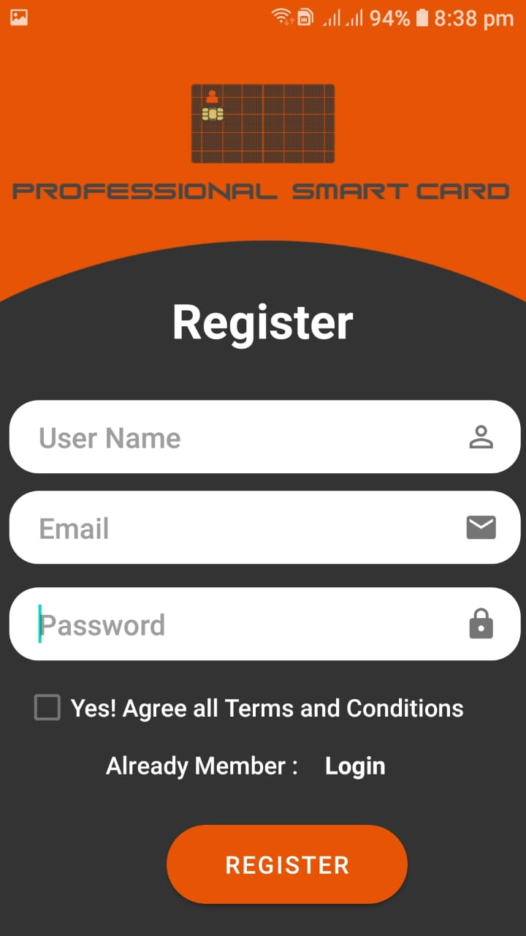
Professional Smart card
_______________________________

Slide 16
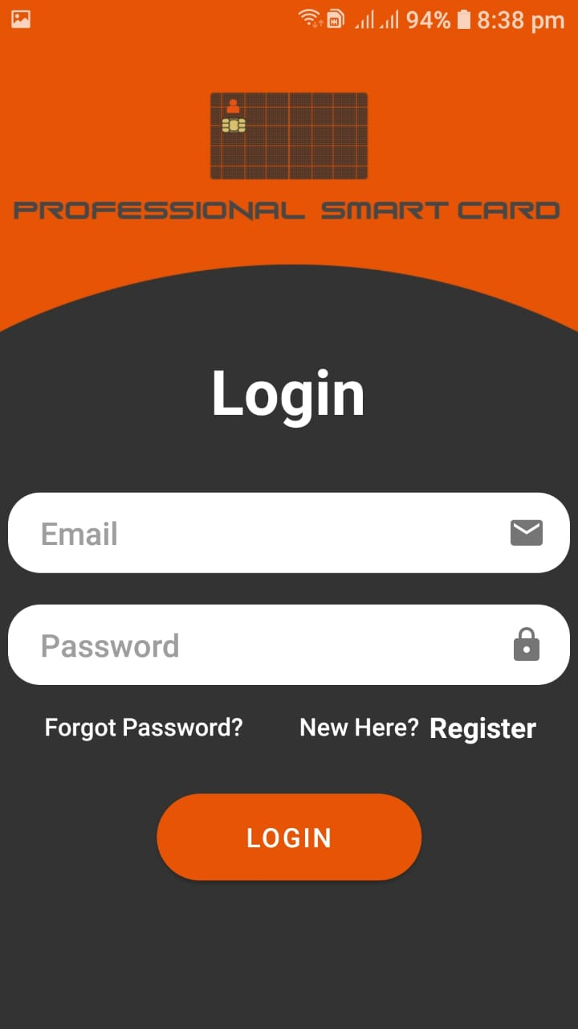
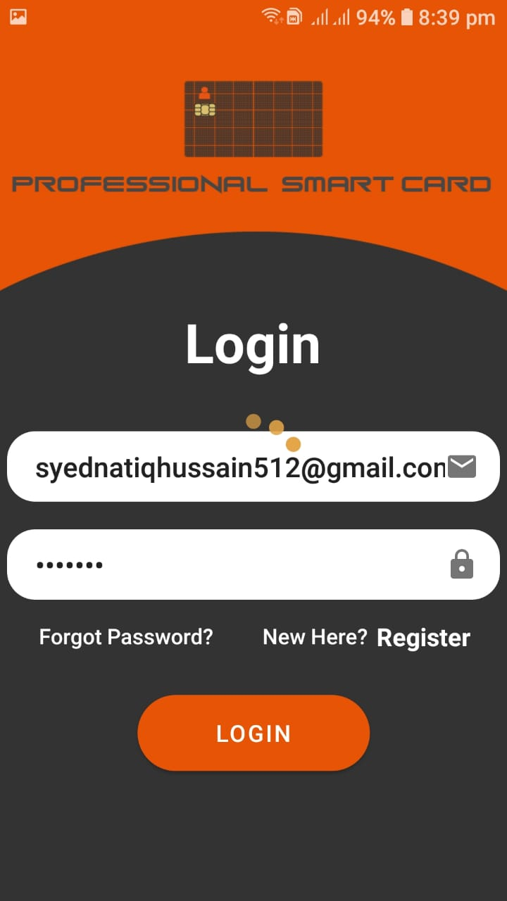
Professional Smart card
_______________________________

Slide 17
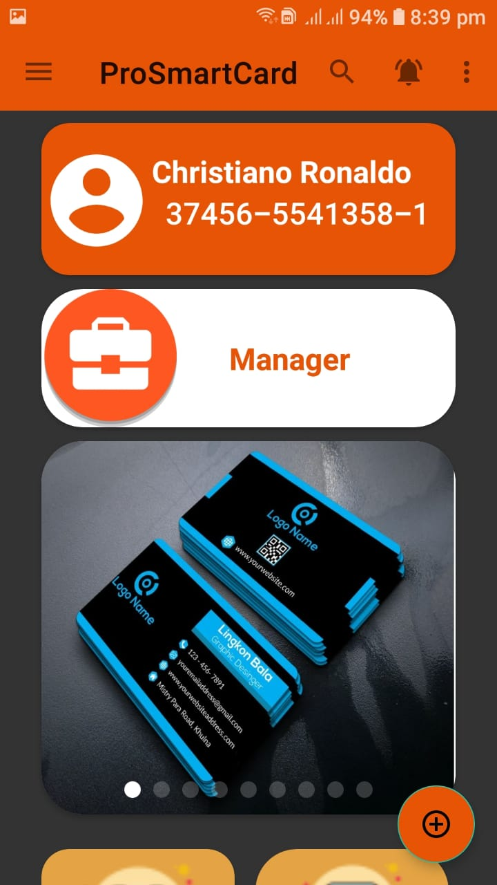
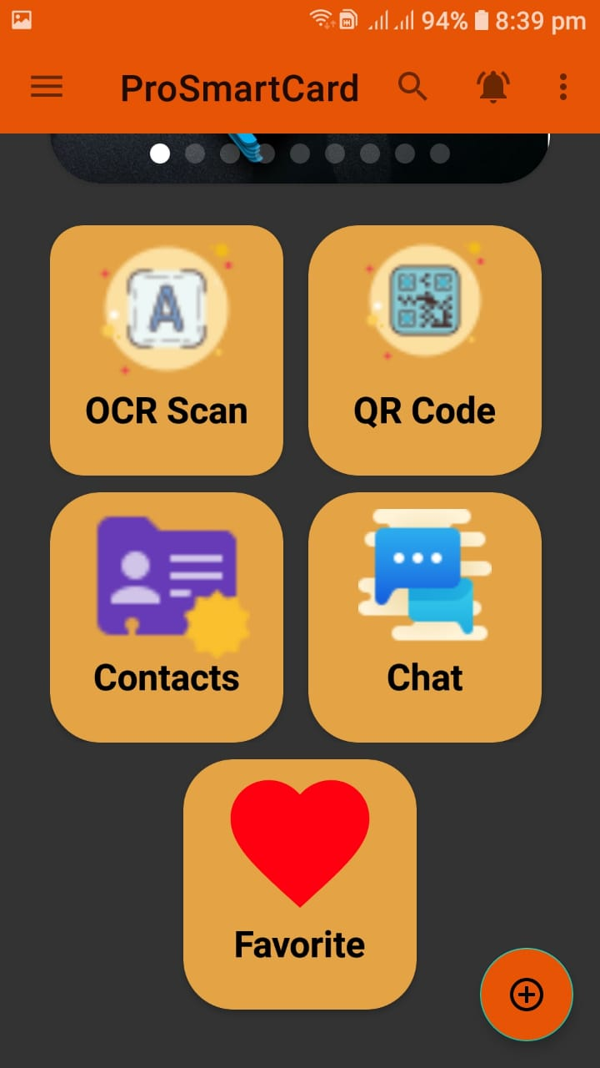
Professional Smart card
_______________________________

Slide 18
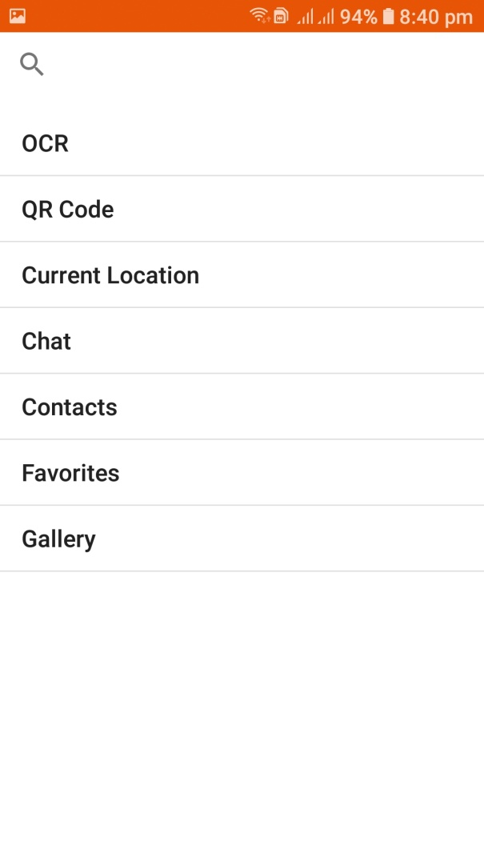
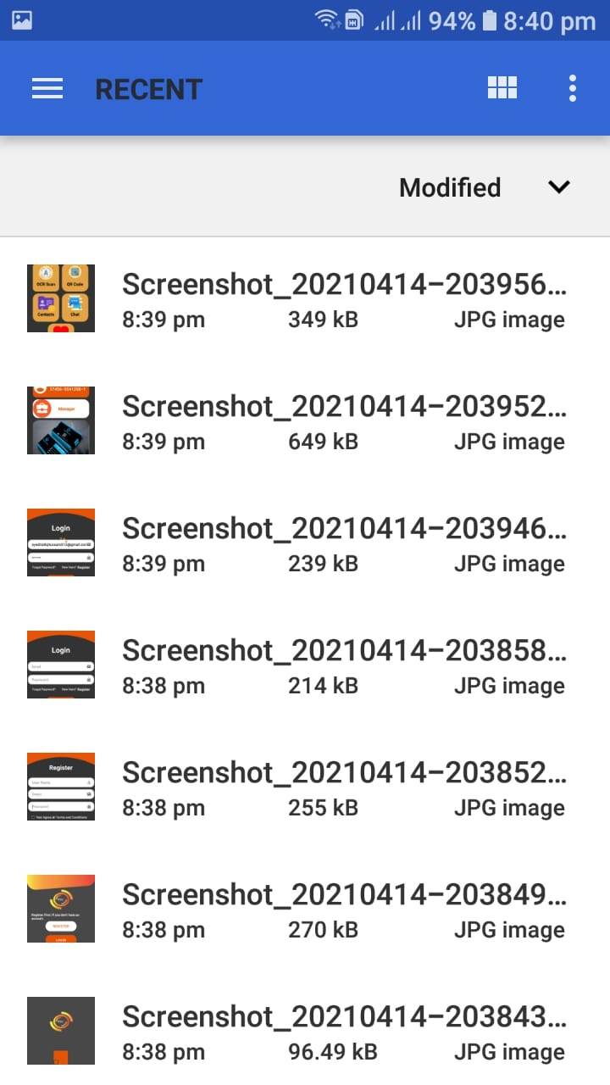
Professional Smart card
_______________________________

Slide 19
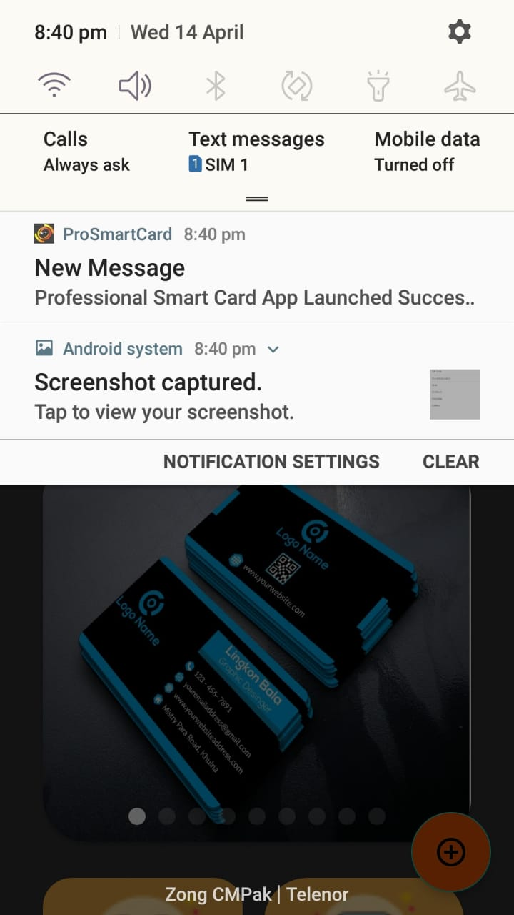
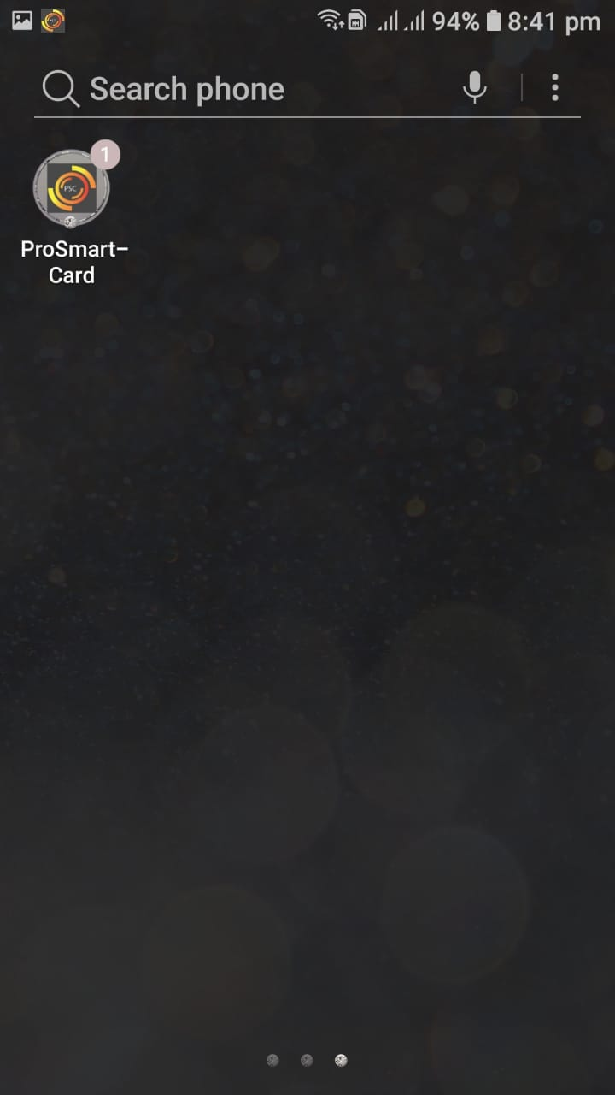
Professional Smart card
_______________________________

Slide 20
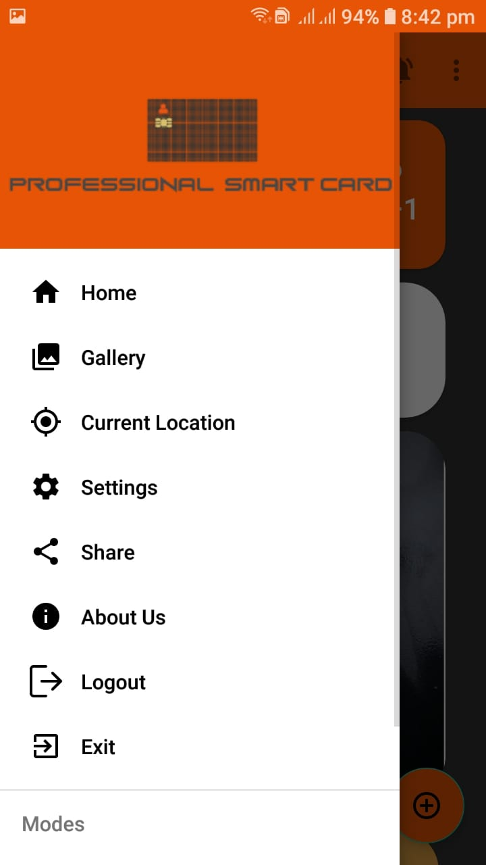
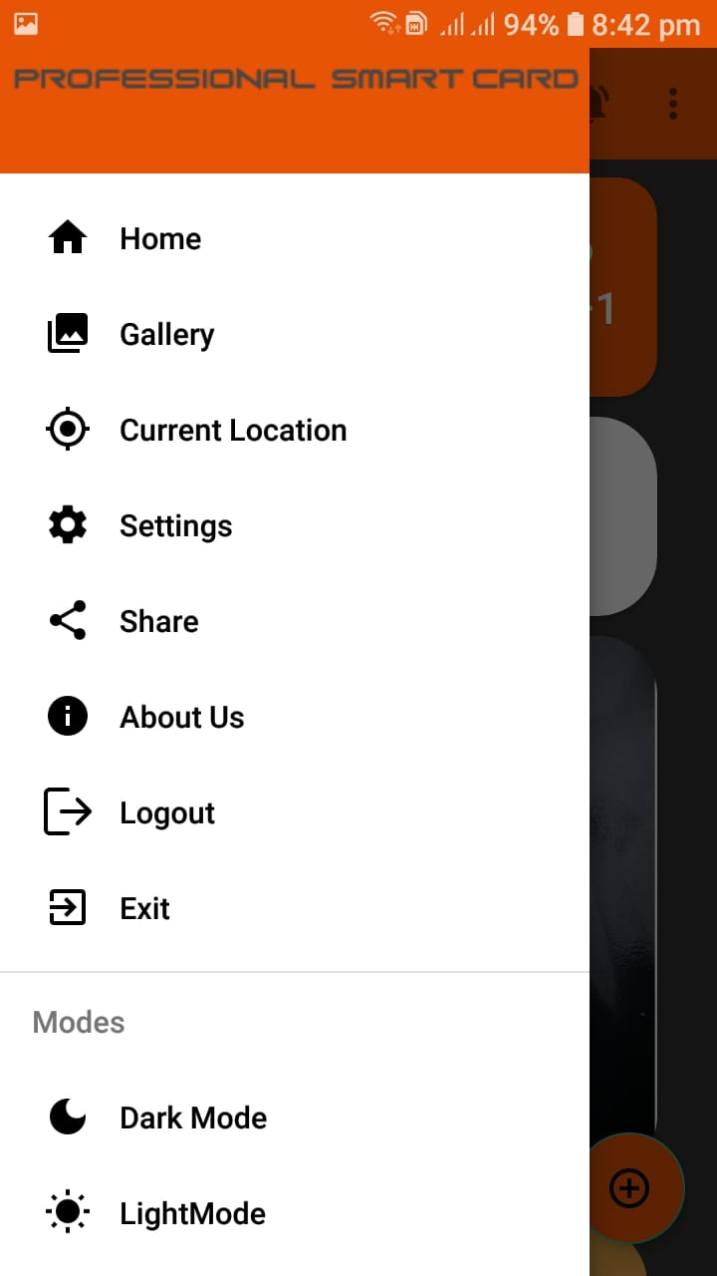
Professional Smart card
_______________________________

Slide 21
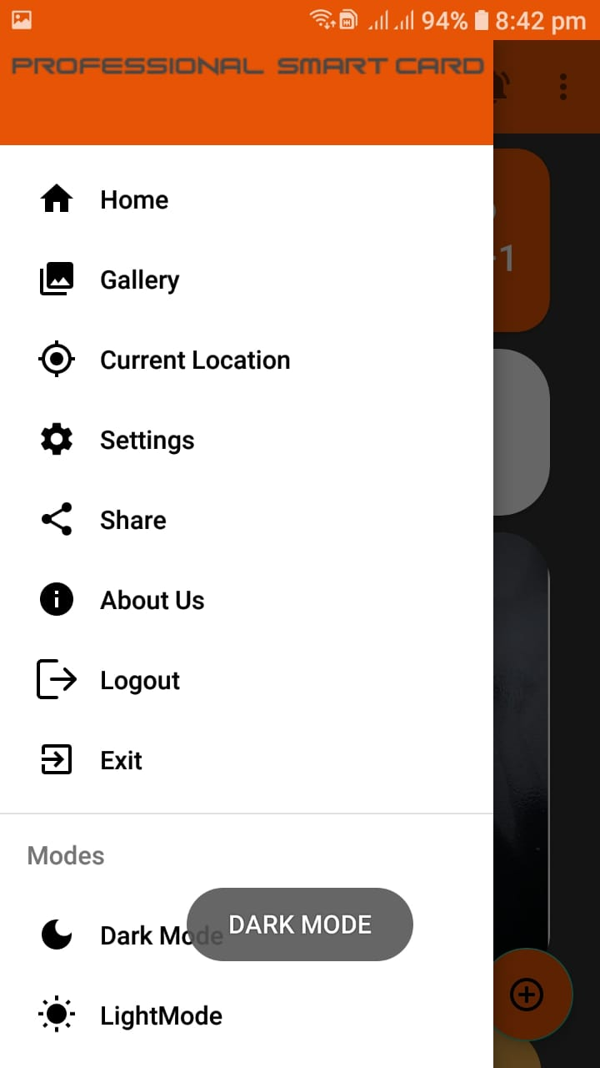
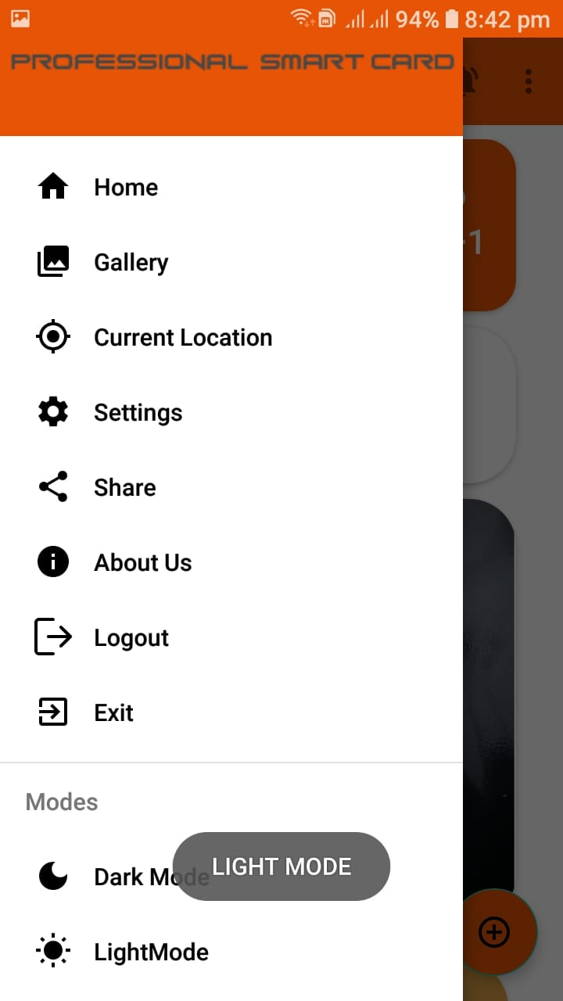
Professional Smart card
_______________________________

Slide 22
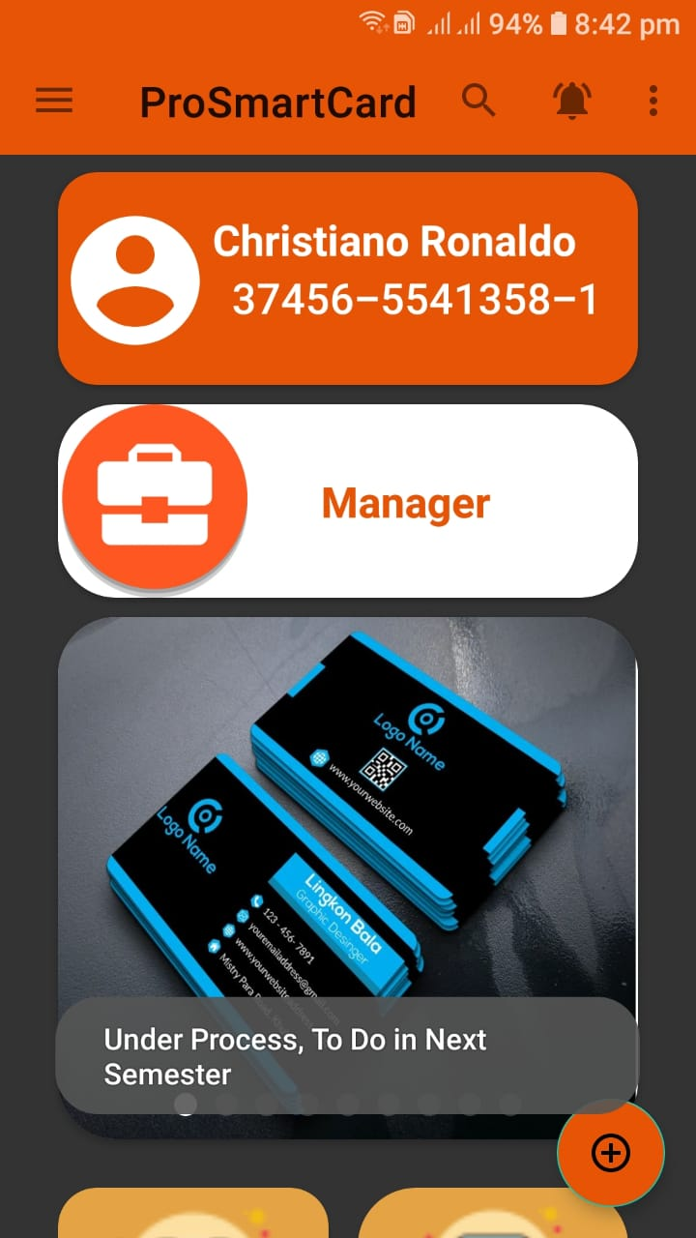
Professional Smart card
_______________________________

Slide 23
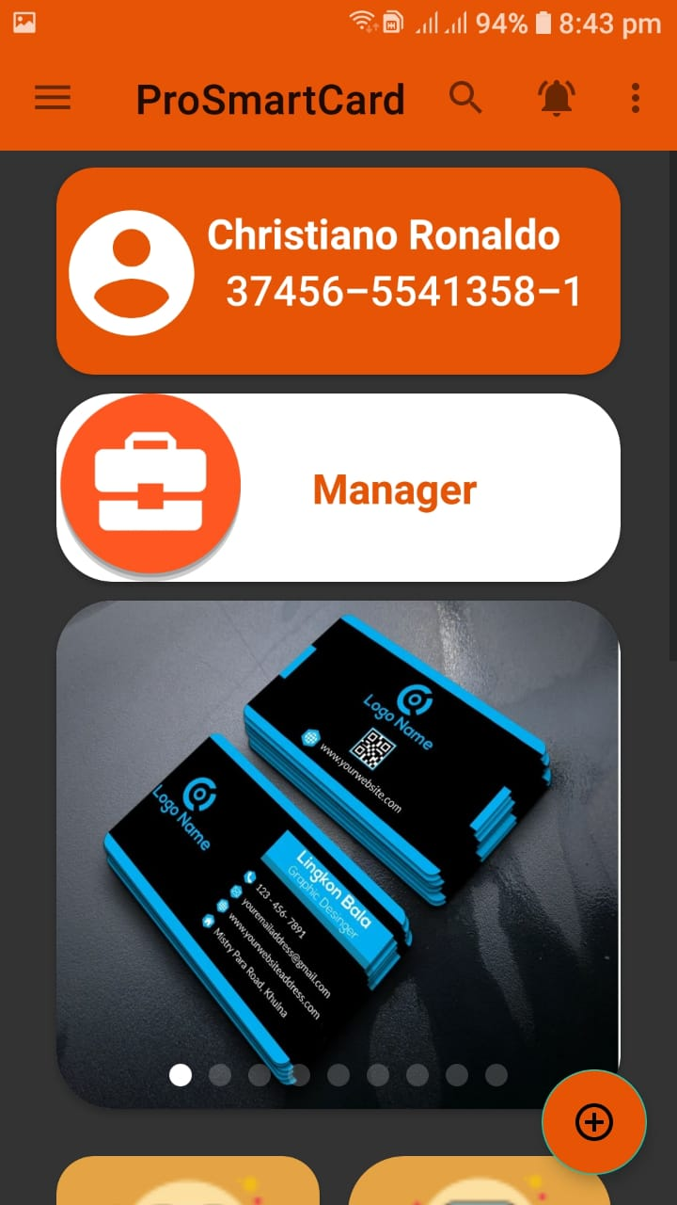
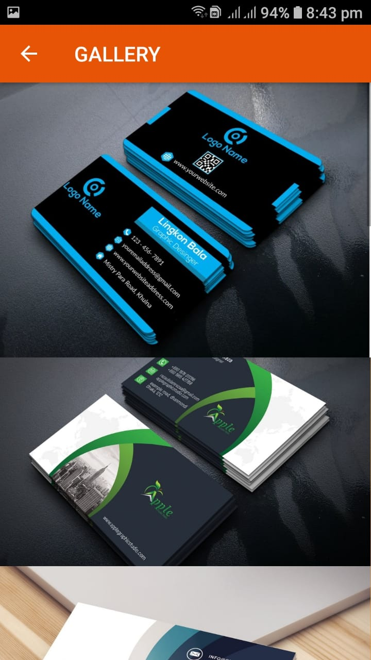
Professional Smart card
_______________________________

Slide 24
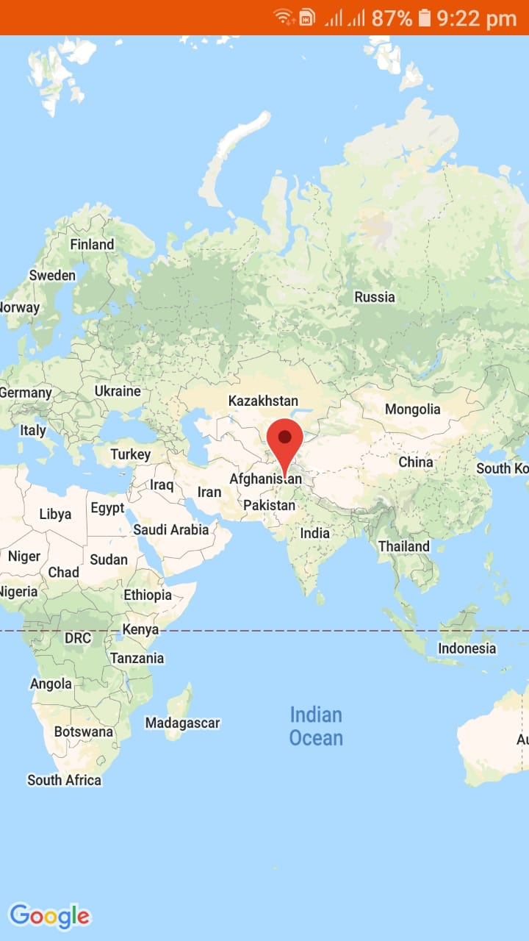
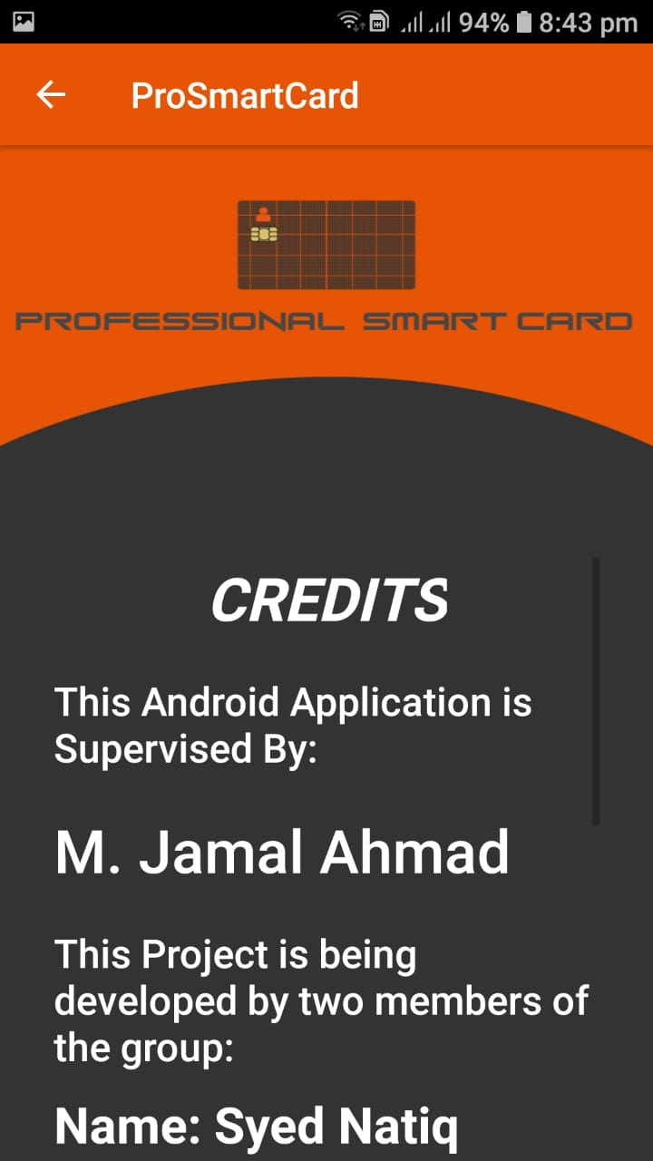
Professional Smart card
_______________________________

Slide 25
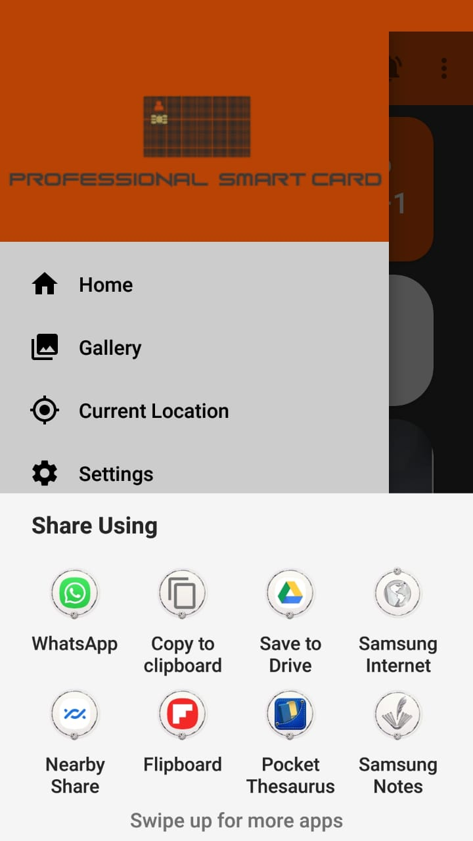
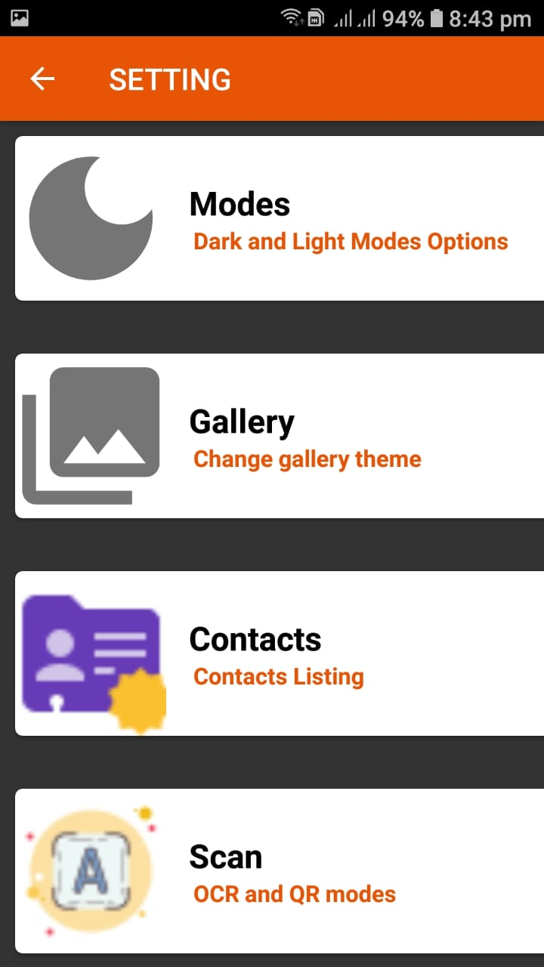
Professional Smart card
_______________________________

Slide 26
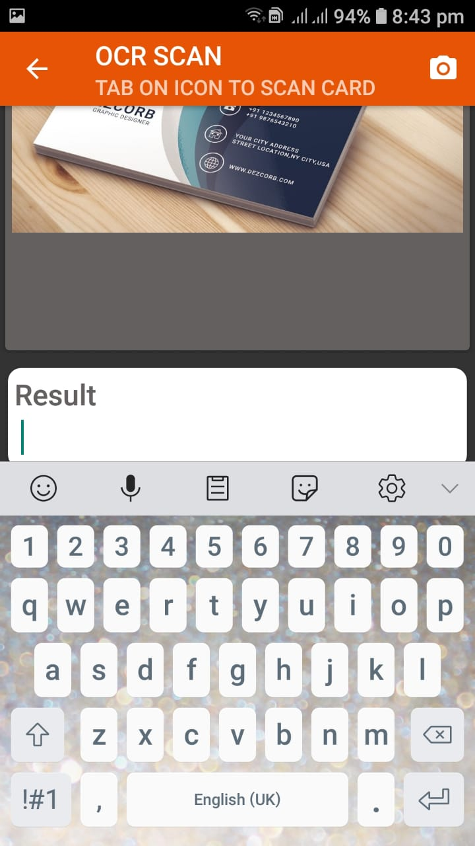
Professional Smart card
_______________________________

Slide 27
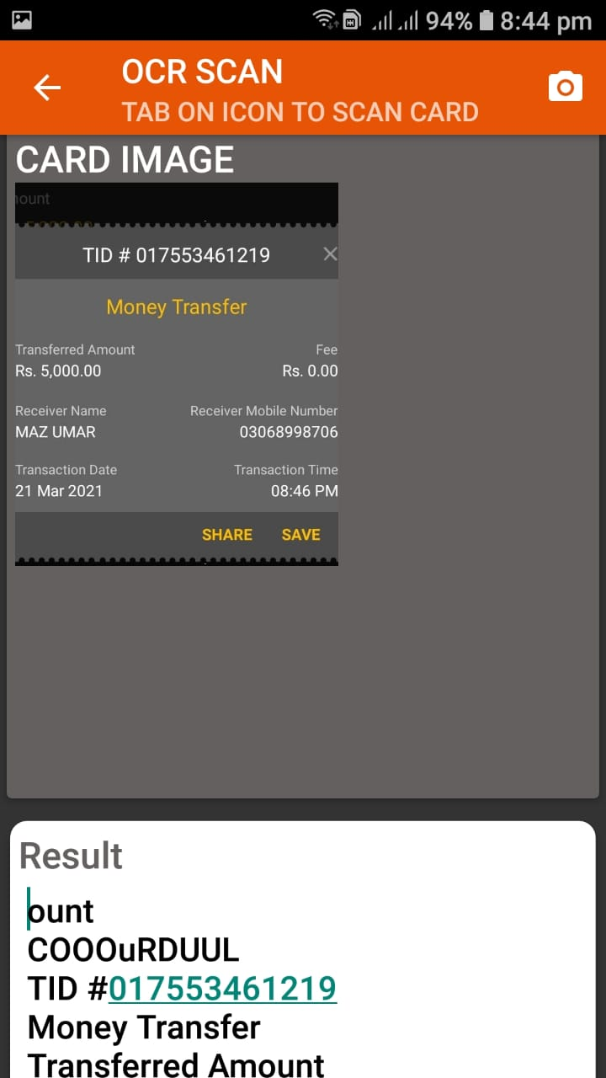
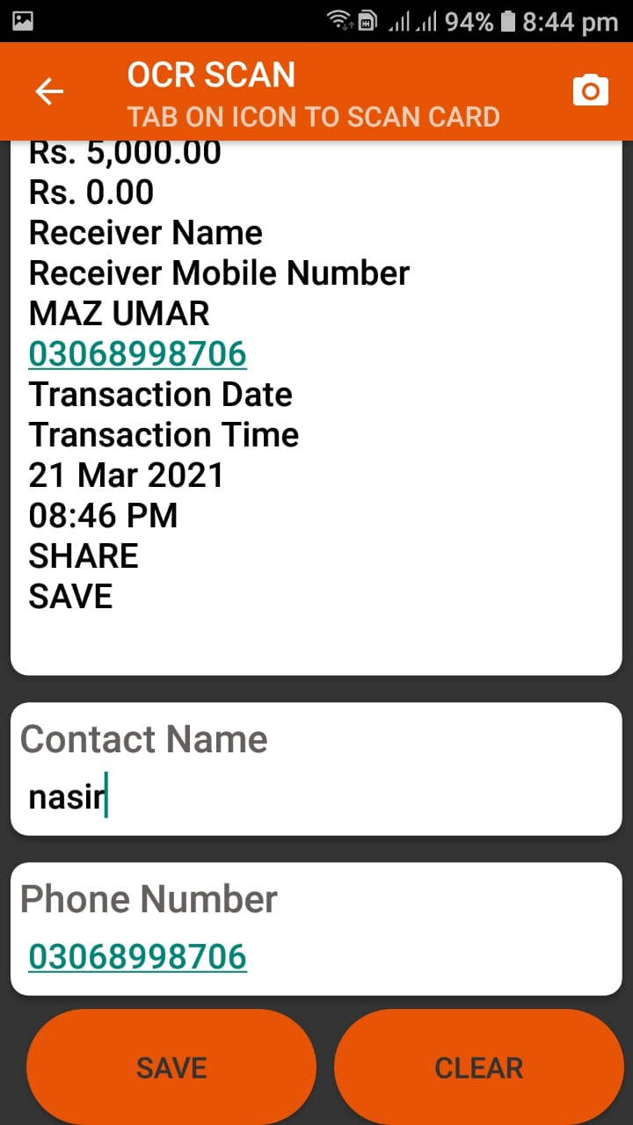
Professional Smart card
_______________________________

Slide 28
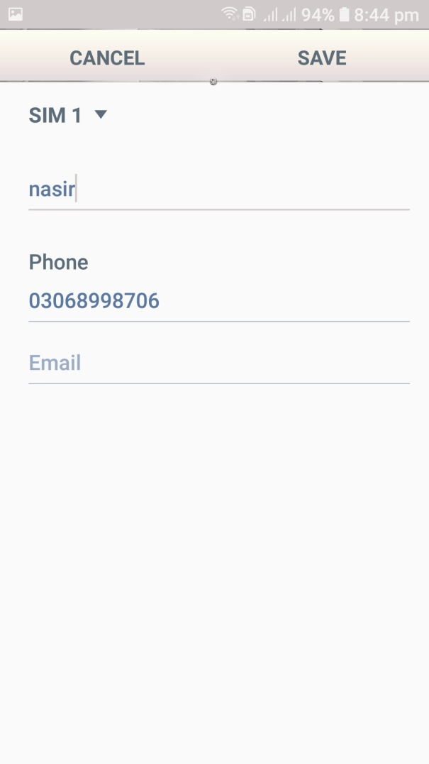
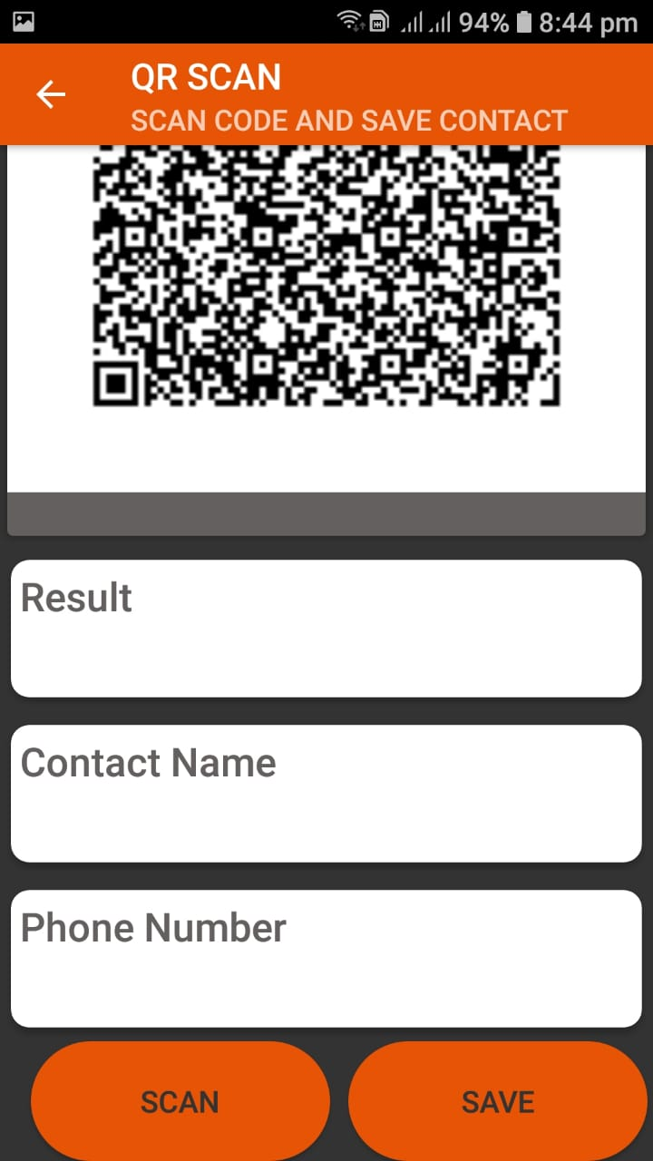
Professional Smart card
_______________________________

Slide 29
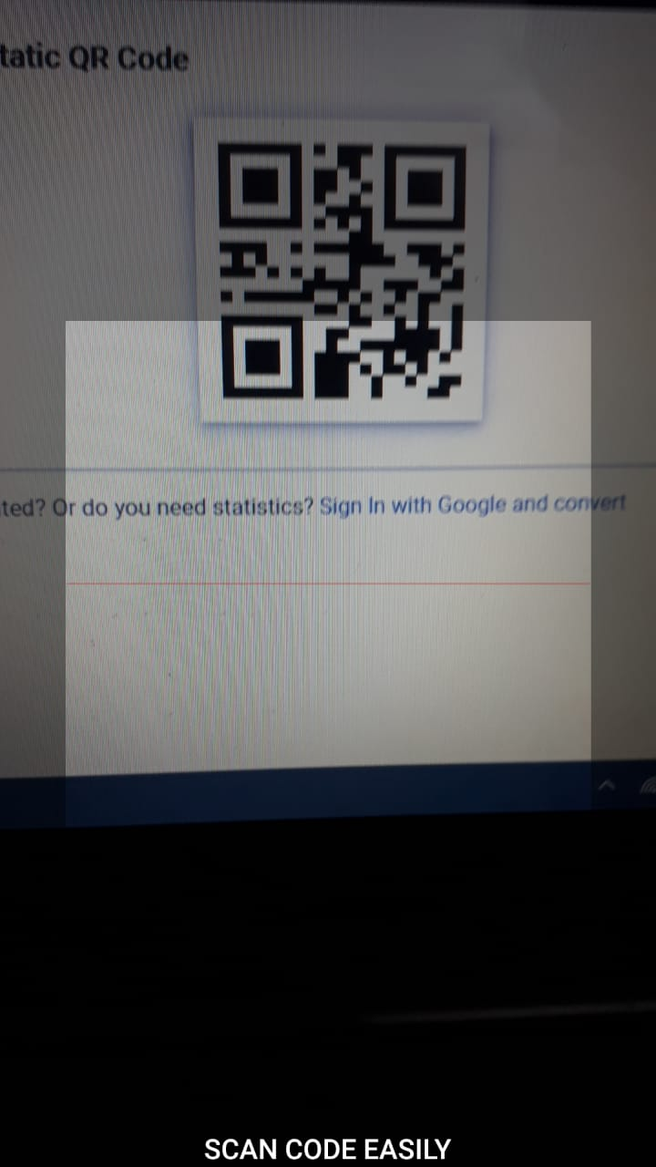
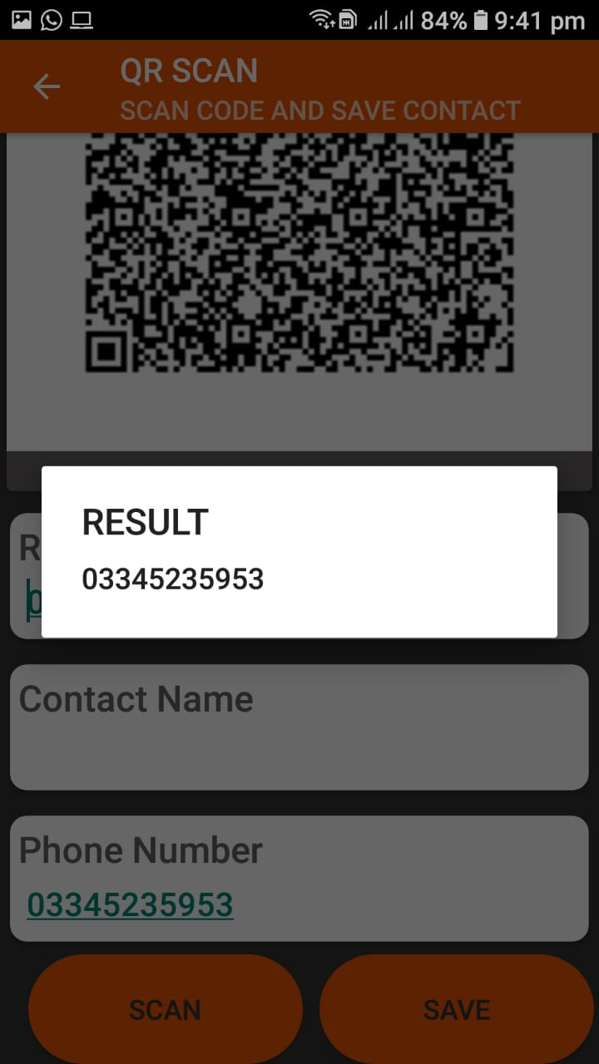
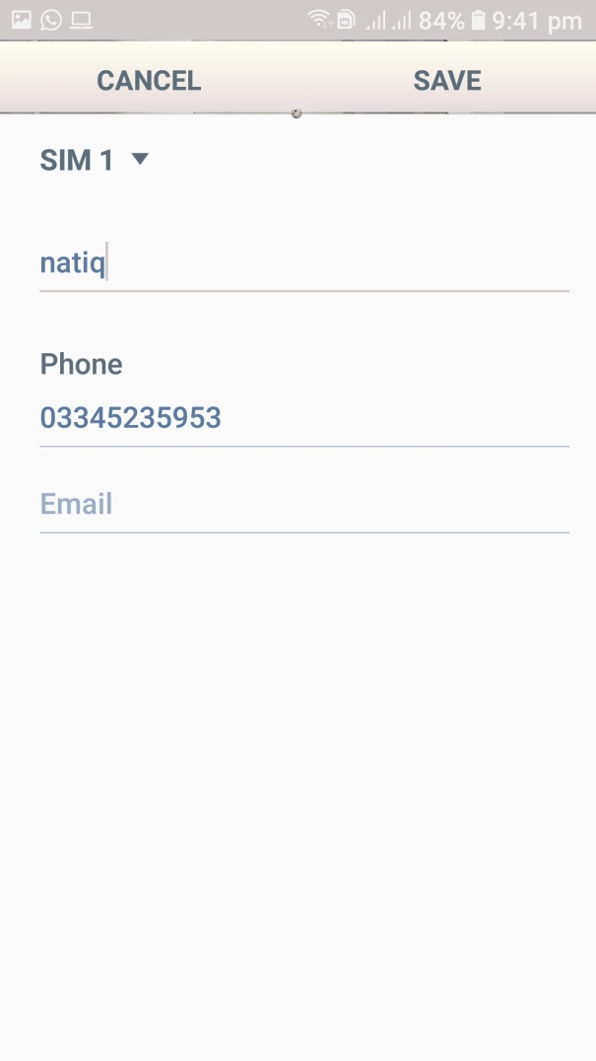
Professional Smart card
_______________________________

Slide 30
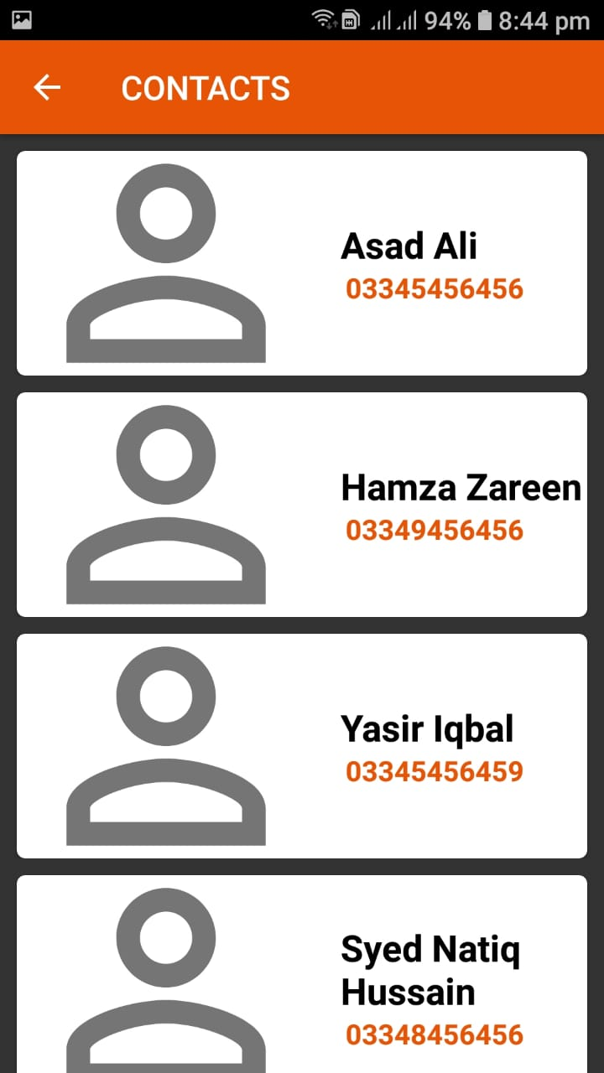
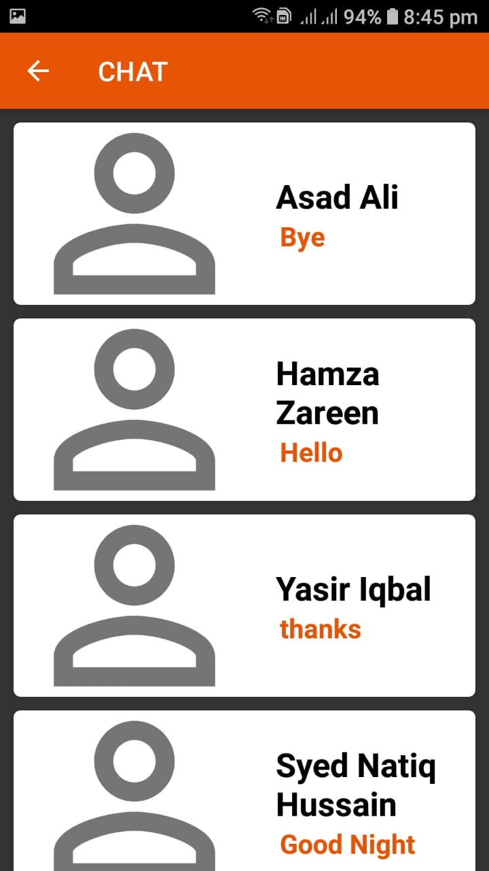
Professional Smart card
_______________________________

Slide 31
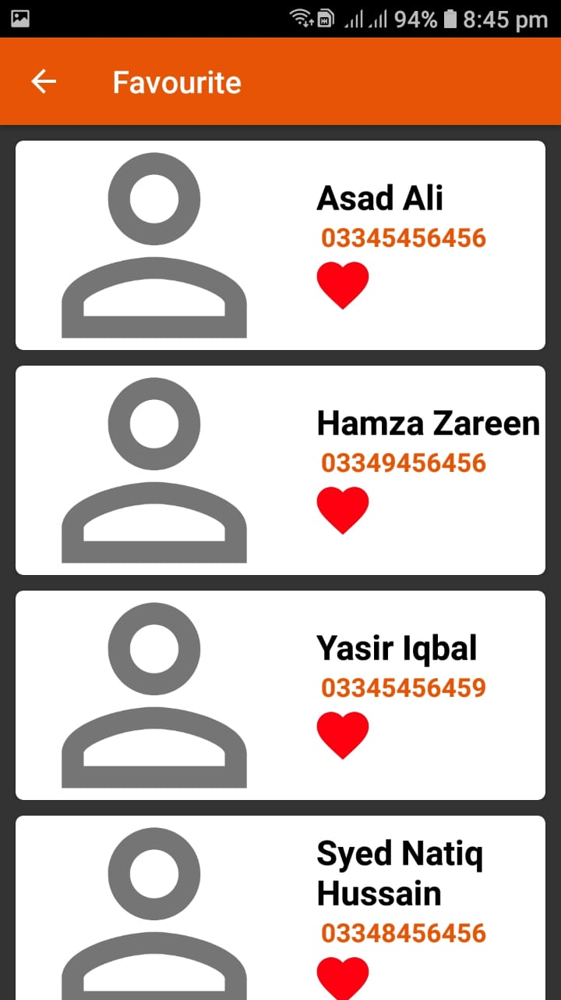
Professional Smart card
_______________________________

Slide 32

_______________________________

